Slide 1


Project housing
HOUSING: PRICE PREDICTION

Slide 2
ABOUT THE CASE STUDY.
Problem Statement:
Houses are one of the necessary need of each and every person around the globe and therefore housing and real estate market is one of the markets which is one of the major contributors in the world’s economy. It is a very large market and there are various companies working in the domain. Data science comes as a very important tool to solve problems in the domain to help the companies increase their overall revenue, profits, improving their marketing strategies and focusing on changing trends in house sales and purchases. Predictive modelling, Market mix modelling, recommendation systems are some of the machine learning techniques used for achieving the business goals for housing companies. Our problem is related to one such housing company.
A US-based housing company named Surprise Housing has decided to enter the Australian market. The company uses data analytics to purchase houses at a price below their actual values and flip them at a higher price. For the same purpose, the company has collected a data set from the sale of houses in Australia.
The data is provided in the CSV file below. The company is looking at prospective properties to buy houses to enter the market. You are required to build a model using Machine Learning in order to predict the actual value of the prospective properties and decide whether to invest in them or not.
For this company wants to know: • Which variables are important to predict the price of variable? • How do these variables describe the price of the house?

Slide 3
WHAT WE HAVE TO DO.
Technical Requirements:
• Data contains 1460 entries each having 81 variables.
• Data contains Null values. You need to treat them using the domain knowledge and your own understanding.
• Extensive EDA has to be performed to gain relationships of important variable and price.
• Data contains numerical as well as categorical variable. You need to handle them accordingly.
• You have to build Machine Learning models, apply regularization and determine the optimal values of Hyper
Parameters.
• You need to find important features which affect the price positively or negatively.
• Two datasets are being provided to you (test.csv, train.csv). You will train on train.csv dataset and predict on
test.csv file.

Slide 4


EXPLORATORY DATA ANALYSIS (EDA)
Exploratory Data Analysis (EDA) is an approach to analyze the data using visual techniques. It is used to discover trends, patterns, or to check assumptions with the help of statistical summary and graphical representations.
Before EDA the data is downloaded and has been called using essential libraries for the purpose of visualization and analysis.

Slide 5

How to do EDA
These are certain steps that are to be performed in EDA:-
Downloading the dataset.
Observe your dataset.
Find any missing values or the null values.
Find the shape of your dataset.
Organizing a dataset.
Understanding variables.
Visual representation of the data for better understanding using seaborn and matplotlib libraries.
Describing the data.
Identify relationships (correlation) in your dataset.

Slide 6
EDA
Before EDA the data is downloaded FROM TRAIN.CSV file and has been called using essential libraries for the purpose of visualization and analysis in the variable (df).
Then the shape is found using the required code which is 1168 rows and 81 columns.
Then the null values present in the data is found using the required code which are then treated using imputation techniques.
Then the unique values are found in the particular columns using required code.
Then we find the duplicate values present in the dataset which is 0

Slide 7
Then we do the visualization of the data using essential libraries (Seaborn and Matplotlib).
Then for describing and finding correlation in the data we will do the encoding of it in order to make is understandable and readable for the computer so that the processing can be done perfectly.
Then describing of the data comes .
The comes finding correlation of the data.
Then removing outliers
Then checking the skewness in the data and removing it.
Then we’ll call TEST.CSV file for the further process of training and building model (there is no need of splitting the data as data is already been splitted )
Then we’ll do cross validation .
Then we’ll do the hyperparameter tunning.
Then we’ll print the r2 score and cross val score
These all steps have been done in the jupyter.

Slide 8


visual representation of the data (eda)

Slide 9
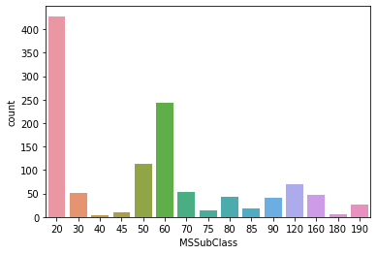
1. Column - MSSubClass

Slide 10
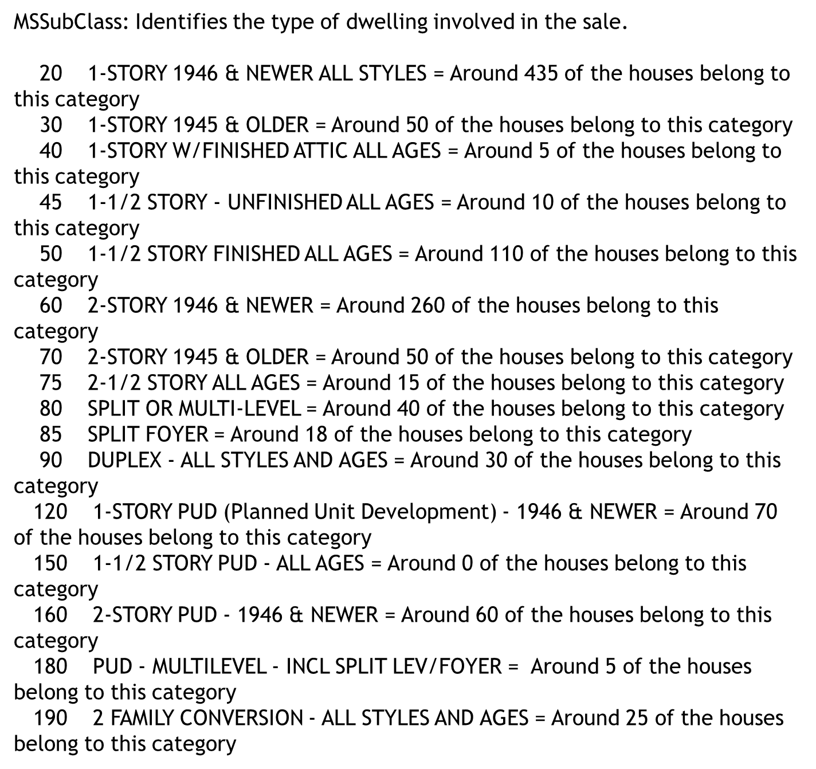

Slide 11
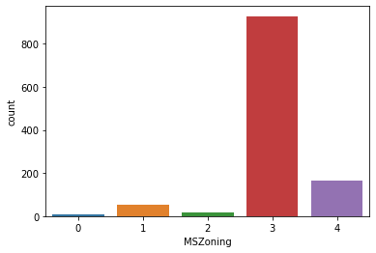
Column - MSZoning.
MSZoning: Identifies the general zoning classification of the sale.
A RH Residential High Density then this with around 60 houses
RL Residential Low Density is mostly the zone of most houses around 900 houses are in this zone
RP Residential Low Density Park then this with around 30 houses
RM Residential Medium Density then comes this zone with around 180 houses

Slide 12
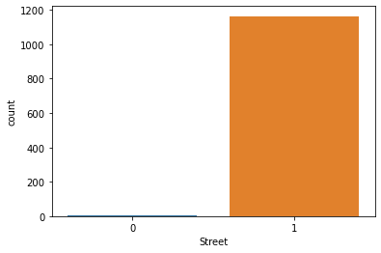
Column - Street
Street: Type of road access to property
Grvl Gravel and gravel one are around 12
Pave Paved most of the streets are paved one around 1156 something

Slide 13
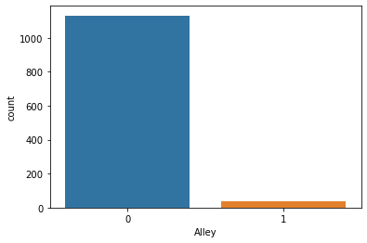
Column- Alley
Alley: Type of alley access to property
Grvl Gravel the road to ally access to property is mostly the gravel one around 1130
Pave Paved then this one around around 38
NA No alley access this is not there cause every property have a access to ally

Slide 14
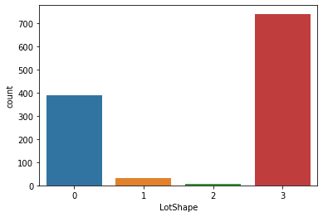
Column- LotShape
LotShape: General shape of property
Reg Regular - most of the properties have regular lot shape around 730
IR1 Slightly irregular - then comes this category with around 390 properties
IR2 Moderately Irregular - then comes this category with around 25 properties
IR3 Irregular - then comes this category with around 4 properties

Slide 15
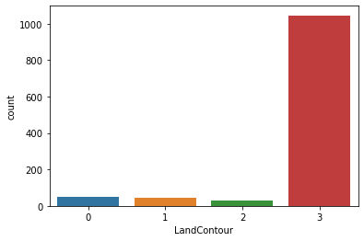
Column- LandContour
) LandContour: Flatness of the property
Lvl Near Flat/Level - most of the houseshave this flatness around 1100
Bnk Banked - Quick and significant rise from street grade to building- then comes this category around 28
HLS Hillside - Significant slope from side to side - then comes this category around 13
Low Depression - then comes this category around 25

Slide 16
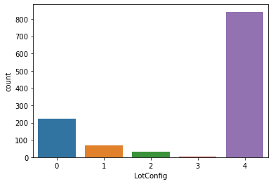
Column- LotConfig
LotConfig: Lot configuration
Inside Inside lot - most of the properties have this configuration around 850
Corner Corner lot - then comes this configuration around 210
CulDSac Cul-de-sac - then comes this configuration around 50
FR2 Frontage on 2 sides of property - then comes this configuration around 30
FR3 Frontage on 3 sides of property - then comes this configuration around 8

Slide 17
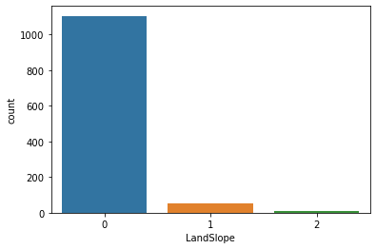
Column- LandSlope
LandSlope: Slope of property
Gtl Gentle slope - most of the properties have gentle slope around 1130
Mod Moderate Slope - then comes this category with around 30 houses
Sev Severe Slope - then comes this category with around 8 houses

Slide 18
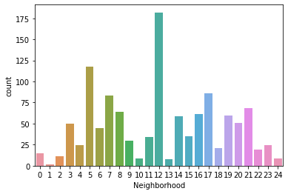
Column- Neighborhood
Neighborhood: Physical locations within Ames city limits . Most of the properties have names = nort ames as the neighborhood then followed by collegcr = college creek then by NWames = north west ames then sawyr west then nridght then oldtown then somerset then edwards then gilbert then stoneBr then brkside then comes NPKvill then No ridge then IDOTERR and the least one is veenker.

Slide 19
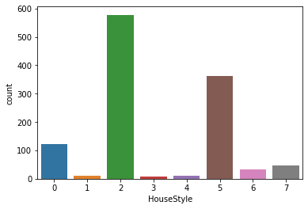
Column- HouseStyle

Slide 20
HouseStyle: Style of dwelling
1Story One story - most of the properties are one story around 570
1.5Fin One and one-half story: 2nd level finished - then most of them are of this category with 120
1.5Unf One and one-half story: 2nd level unfinished - then with this category with 10
2Story Two story - then most of them are of this category with 360
2.5Fin Two and one-half story: 2nd level finished - then with this category with 30
2.5Unf Two and one-half story: 2nd level unfinished- then with this category with 6
SFoyer Split Foyer - then of this category with 40 properties
SLvl Split Level - then with this category with 12

Slide 21
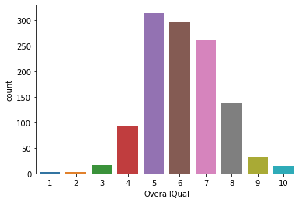
Column- OverallQual

Slide 22
OverallQual: Rates the overall material and finish of the house
10 Very Excellent - then after fair comes the very excellent one
9 Excellent - then after below average comes excellent
8 Very Good - then after good comes the very good one
7 Good - then comes good after above average
6 Above Average - then most of them are above average after average
5 Average - most of the properties are rated to be average
4 Below Average - then after very good comes below average
3 Fair - then after excellent comes the fair one
2 Poor - then after very excelent comes the poor
1 Very Poor - and the last one is very poor

Slide 23
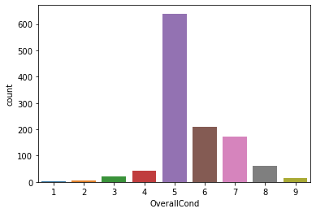
Column- OverallCond
OverallCond: Rates the overall condition of the house .
10 Very Excellent
9 Excellent
8 Very Good
7 Good
6 Above Average
5 Average
4 Below Average
3 Fair
2 Poor
1 Very Poor
this graph tells the overall condition of the properties most of the properties are average then comes above average then comes good then comes very good then the below average then comes the fair then excellent then the poor and at last comes very poor.

Slide 24
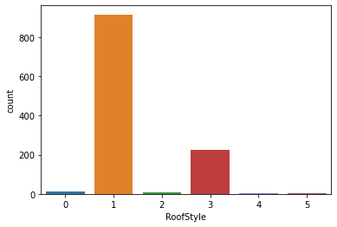
Column- RoofStyle
RoofStyle: Type of roof
Flat Flat - then comes the flat one with 20 properties
Gable Gable - most of the houses have the roof type of gable around 900
Gambrel Gabrel (Barn) - then the roofstyle with 15 properties
Hip - Hip then comes the hip with around 260 propertie
Mansard Mansard - then this category
Shed Shed - shed is the last one

Slide 25
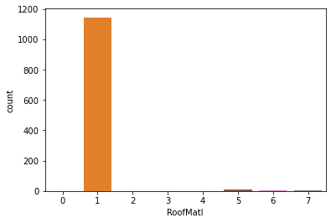
Column- RoofMatl
RoofMatl: Roof material
ClyTile Clay or Tile
CompShg Standard (Composite) Shingle - most of the houses have the roof material of this category around 1140
Membran Membrane
Metal Metal
Roll Roll
Tar&Grv Gravel & Tar - then after that comes this category with around 10 properties
WdShake Wood Shakes - then after that comes this category with around 4 properties
WdShngl Wood Shingles - then after that comes this category with around 4 properties

Slide 26
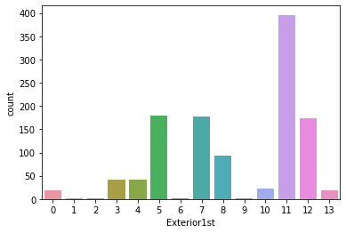
Column- Exterior1st

Slide 27
Exterior1st: Exterior covering on house
0 AsbShng Asbestos Shingles - then of this with around 20 properties
1 AsphShn Asphalt Shingles - then of this with around 5 properties
2 BrkComm Brick Common - then of this with around 5 properties
3 BrkFace Brick Face - then of this with around 30 properties
4 CBlock Cinder Block - then of this with around 40 properties
5 CemntBd Cement Board - then of this with around 175 properties
6 HdBoard Hard Board - then of this with around 5 properties
7 ImStucc Imitation Stucco -then of this with around 170 properties
8 MetalSd Metal Siding - then of this with around 90 properties
9 Other Other - then of this with around 8 properties
10 Plywood Plywood
11 PreCast PreCast - most of them are of this category around 400
12 Stone Stone - then of this with around 165 properties
13 Stucco Stucco - then of this with around 15 proper

Slide 28
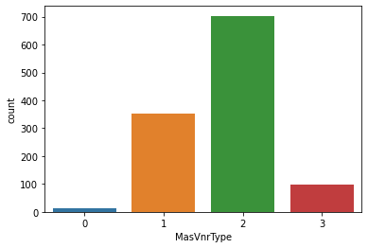
Column- MasVnrType
MasVnrType: Masonry veneer type
BrkCmn Brick Common - then comes this category with around 28
BrkFace Brick Face - then comes this category with around 350
CBlock Cinder Block - most of the house have masonry veneer of this type around 690 properties
None None then comes those properties that doesn't have the masonry with around 100
Stone Stone

Slide 29
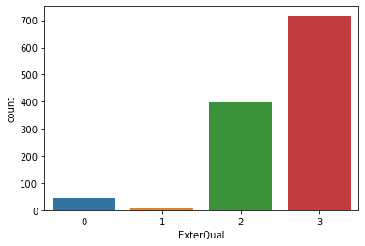
Column- ExterQual
ExterQual: Evaluates the quality of the material on the exterior
Ex Excellent - then comes the excellent quality material which is used by very less properties around 50
Gd Good - then at last comes the good material in around 8 properties
TA Average/Typical - then comes the average material in 390 properties
Fa Fair - most of the properties exterior material is of fair quality in around 710 properties Po Poor

Slide 30
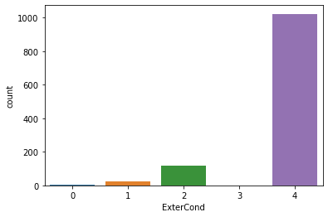
Column- ExterCond
ExterCond: Evaluates the present condition of the material on the exterior
Ex Excellent - then comes excellent condition of around 8 properties
Gd Good - then comes the good condition of around 50
TA Average/Typical - then comes the average condition of around 100 houses
Fa Fair
Po Poor most pof the properties exrerior condition is poor properties around 1000 have poor condition

Slide 31
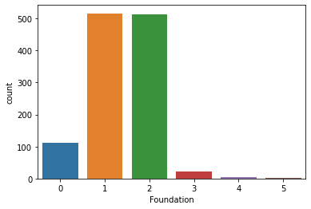
Column- Foundation
Foundation: Type of foundation
BrkTil Brick & Tile - - then some of them have a foundation of this type around 110
CBlock Cinder Block - most of them have a foundation of this type around 505
PConc Poured Contrete - then most of them have a foundation of this type around 500
Slab Slab - - then some have a foundation of this type around 25
Stone Stone - then some have a foundation of this type around 18
Wood Wood - then the last few of them have a foundation of this type around 10

Slide 32
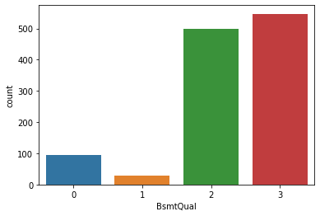
Column-BsmtQual
BsmtQual: Evaluates the height of the basement
Ex Excellent (100+ inches) - then comes the properties that have a basement height of this type around 90
Gd Good (90-99 inches) - then comes the properties that have a basement height of this type around 38
TA Typical (80-89 inches) - then comes the properties that have a basement height of this type around 470
Fa Fair (70-79 inches) - most of the properties have a basement height of this type around 550
Po Poor (<70 inches
NA No Basement

Slide 33
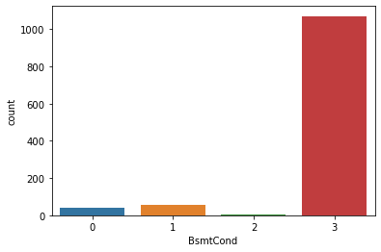
Column- BsmtCond
BsmtCond: Evaluates the general condition of the basement
Ex Excellent - then comes the basement with excellent condition around 20
Gd Good - then comes the basement with good condition 30
TA Typical - slight dampness allowed - then comes the basement with typical condition around 8 properties.
Fa Fair - dampness or some cracking or settling - most of the properties have fair condition of the basement around 1100
Po Poor - Severe cracking, settling, or wetness
NA No Basement

Slide 34
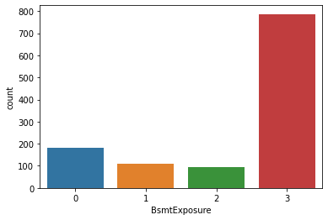
Column- BsmtExposure
BsmtExposure: Refers to walkout or garden level walls
Gd Good Exposure - then after no exposure comes the good exposure category with maximum number of properties
Av Average Exposure (split levels or foyers typically score average) - then comes this category after gdor above
Mn Mimimum Exposure - then after av comes minimum exposure.
No No Exposure - most of the properties belong to this category
NA No Basement

Slide 35
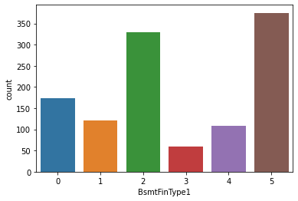
Column- BsmtFinType1
BsmtFinType1: Rating of basement finished area
GLQ Good Living Quarters - then comes the basements in this category around 175
ALQ Average Living Quarters - then comes the basements in this category around 125
BLQ Below Average Living Quarters - then comes the basements in this category around 325
Rec Average Rec Room - then comes the basements in this category around 58
LwQ Low Quality - then comes the basements in this category around 110
Unf Unfinshed - most of the properties have unfineshed basements around 400
NA No Basement

Slide 36
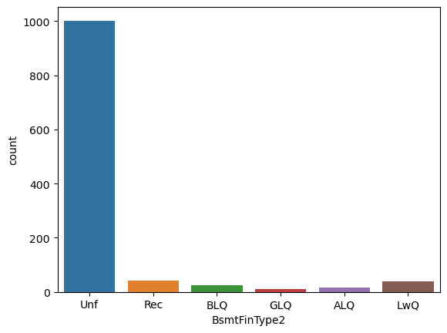
Column BsmtFinType2
BsmtFinType2: Rating of basement finished area (if multiple types)
GLQ Good Living Quarters - then around 4 of them have this category of basement
ALQ Average Living Quarters- then around 8 of them have this category of basement
BLQ Below Average Living Quarters - then around 10 of them have this category of basement
Rec Average Rec Room - then around 15 of them have this category of basement
LwQ Low Quality - then around 20 of them have lowQ basement
Unf Unfinshed - around 1000 of them have unfinished basement
NA No Basement

Slide 37
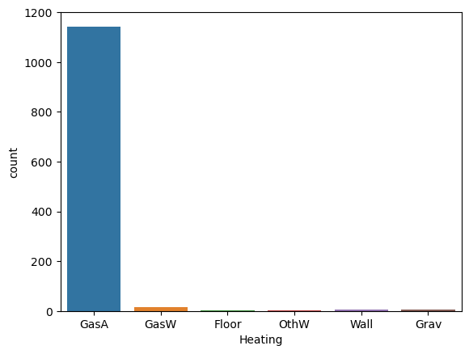
Column - heating
Heating: Type of heating
Floor Floor Furnace - then very very few of the houses have this category of heating type after othW
GasA Gas forced warm air furnace - most of the houses have this category of heating type
GasW Gas hot water or steam heat -then some of the houses have this category of heating type
Grav Gravity furnace - then some of the houses have this category of heating type after grav
OthW Hot water or steam heat other than gas - then some have of the houses have this category of heating type after grav
Wall Wall furnace - then some of the houses have this category of heating type after gasW

Slide 38
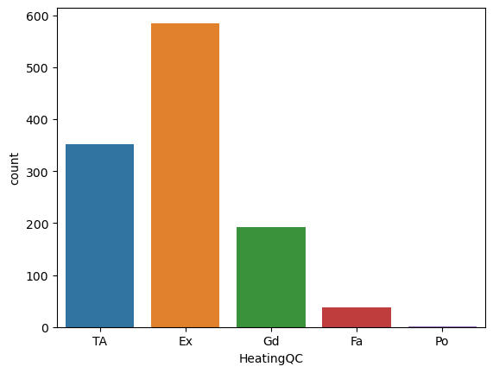
Column- HeatingQC
HeatingQC: Heating quality and condition
Ex Excellent - around 585 house have excellent heating quality
Gd Good - around 200 house have good heating quality
TA Average/Typical- around 350 house have TA heating quality
Fa Fair - around 40 house have fair heating quality
Po Poor -- around 3 house have poor heating quality

Slide 39
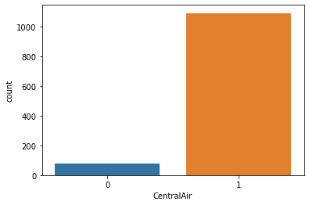
Column- CentralAir
CentralAir: Central air conditioning
N No- then around 68 of the them are not cenral air conditioned
Y Yes - most of the properties are central air conditioned around 1100

Slide 40
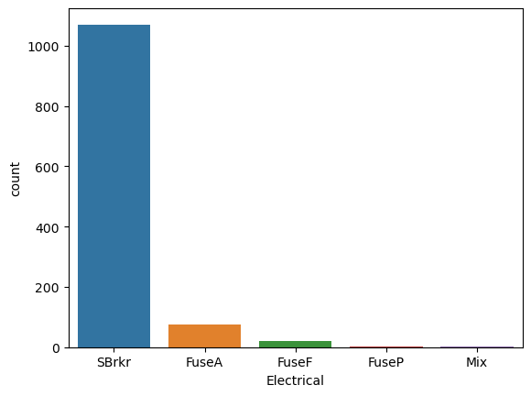
Column- Electrical
Electrical: Electrical system
SBrkr Standard Circuit Breakers & Romex - most of the houses have the standard circuit around 1100
FuseA Fuse Box over 60 AMP and all Romex wiring (Average) then this with around 40 houses
FuseF 60 AMP Fuse Box and mostly Romex wiring (Fair)-then this with around 15
FuseP 60 AMP Fuse Box and mostly knob & tube wiring (poor) - then this with around 8 properties
Mix Mixed - then this in around 5 properties

Slide 41
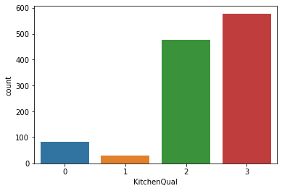
Column- KitchenQual
KitchenQual: Kitchen quality
Ex Excellent - then comes properties kitchen quality with this category around 80 houses
Gd Good - then comes properties kitchen quality with this category around 38 houses
TA Typical/Average - then comes properties kitchen quality with this category around 480 houses
Fa Fair - most of the properties kitchen quality is average around 580 houses
Po Poor

Slide 42
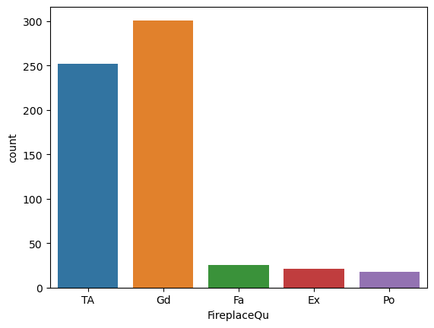
Column- FireplaceQu
FireplaceQu: Fireplace quality
Ex Excellent - Exceptional Masonry Fireplace
Gd Good - Masonry Fireplace in main level
TA Average - Prefabricated Fireplace in main living area or Masonry Fireplace in basement
Fa Fair - Prefabricated Fireplace in basement
Po Poor - Ben Franklin Stove
NA No Fireplace
most of the houses have good fireplace quality around 300, then followed by average around 250 , then comes the fair quality ones with around 30 houses , then the excellent ones around 25 properties then last one fair quality one around 20 properties

Slide 43
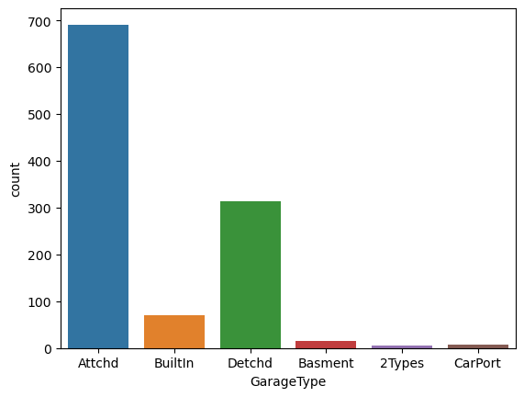
Column- GarageType
GarageType: Garage location
2Types More than one type of garage - then comes the properties that have 2types garage after carport one
Attchd Attached to home - most of the properties have garage attached to home
Basment Basement Garage - then comes the properties that have basement garage after bulitin one
BuiltIn Built-In (Garage part of house - typically has room above garage) - then comes the properties that have builtin garage after detached one
CarPort Car Port - then comes the properties that have carport garage after basement one
Detchd Detached from home - then comes the properties that have detached garage after attached one
NA No Garage

Slide 44
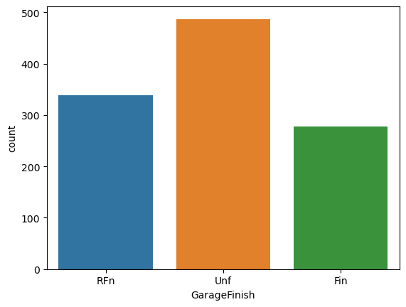
Column-GarageFinish
GarageFinish: Interior finish of the garage
Fin Finished - then at last comes the properties whose garage is finished
RFn Rough Finished- then after unfinished comes the rough finished
Unf Unfinished - most of the garage have unfinished interior
NA No Garage

Slide 45
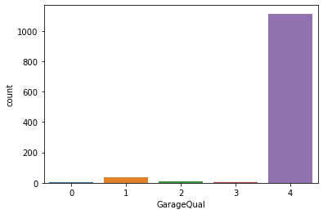
Column-GarageQual
GarageQual: Garage quality
Ex Excellent - then comes garage condition of the properties that fall in this category around 5 properties
Gd Good - then comes garage condition of the properties that fall in this category around 20 properties
TA Typical/Average - - then comes garage condition of the properties that fall in this category around 8 property
Fa Fair - then comes garage condition of the properties that fall in this category around 5 properties
Po Poor - garage quality of most of the properties is falling in this category around 1130 properties
NA No Garage

Slide 46
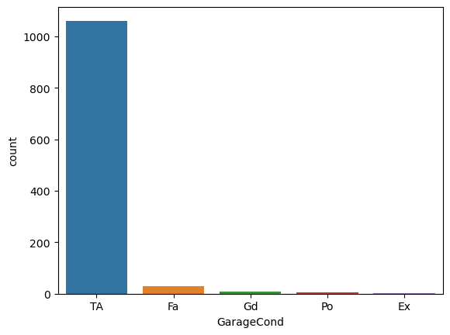
Column-GarageCond
GarageCond: Garage condition
Ex Excellent - then after poor the category with the least properties is this
Gd Good - then comes this category
TA Typical/Average - this is the condition of most of the properties 1100
Fa Fair - then comes this category
Po Poor - then after good comes poor category
NA No Garage

Slide 47
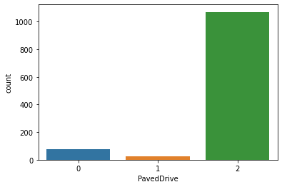
Column-PavedDrive
PavedDrive: Paved driveway
Y Paved - then comes the properties in this category around 50 properties
P Partial Pavement - then comes the properties in this category around 18 properties
N Dirt/Gravel - most of the properties have gravel driveway around 1100 houses

Slide 48
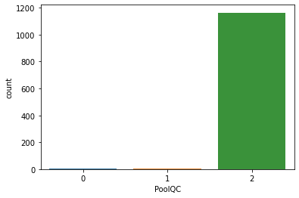
Column-PoolQC
PoolQC: Pool quality
Ex Excellent - then comes properties with pool qualoity of this category around 9
Gd Good - then comes properties with pool qualoity of this category around 9
TA Average/Typical - maximum number of houses have pool quality of this category around 1150
Fa Fair
NA No Pool

Slide 49
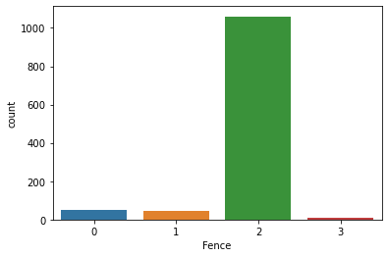
Column-Fence
Fence: Fence quality
GdPrv Good Privacy - then comes the properties under this category around 20 properties
MnPrv Minimum Privacy - then comes the properties under this category around 20 properties
GdWo Good Wood - maximum houses have good wood fence around 1120 properties
MnWw Minimum Wood/Wire - then comes the properties under this category around 8 properties
NA No Fence

Slide 50
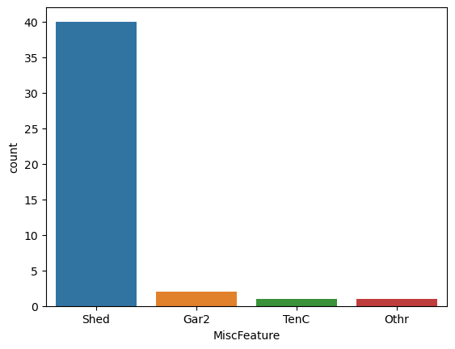
Column-MiscFeature
MiscFeature: Miscellaneous feature not covered in other categories
Elev Elevator
Gar2 2nd Garage (if not described in garage section) - then after shed this category comes
Othr Other - then after othr this category comes
Shed Shed (over 100 SF) - most of the categories have this miscellaneous not coverd
TenC Tennis Court - then after tenC this category comes
NA None

Slide 51
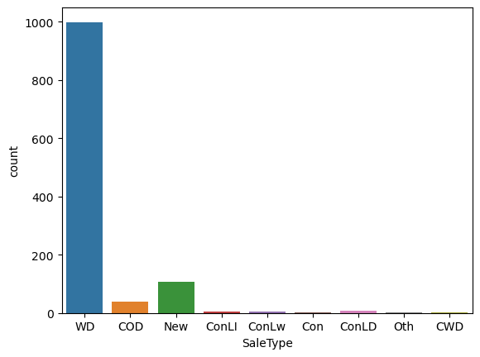
Column-SaleType

Slide 52
SaleType: Type of sale
WD Warranty Deed - Conventional - most of the properties are of this type sale
CWD Warranty Deed - Cash - then after conLI most of the properties are of this sale type
VWD Warranty Deed - VA Loan
New Home just constructed and sold - then after wd most of the properties are of this sale type
COD Court Officer Deed/Estate - then after new most of the properties are of this sale type
Con Contract 15% Down payment regular terms
ConLw Contract Low Down payment and low interest - then after ConLD most of the properties are of this sale type
ConLI Contract Low Interest -- then after ConLI most of the properties are of this sale type
ConLD Contract Low Down - then after COD most of the properties are of this sale type
Oth Other - then after CWD most of the properties are of this sale type

Slide 53
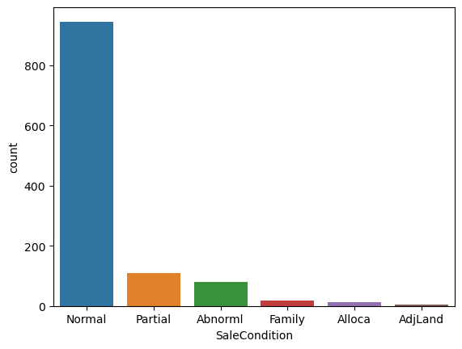
Column- SaleCondition
Normal
Normal Sale - most of the properties are of this category Abnorml
Abnormal Sale - trade, foreclosure, short sale - then comes this after partial
AdjLand Adjoining Land Purchase- then at last comes this category
Alloca Allocation - two linked properties with separate deeds, typically condo with a garage unit – after family comes this category
Family Sale between family members - after abnormal comes the family category
Partial Home was not completed when last assessed (associated with New Homes) - after normal comes the partial

Slide 54
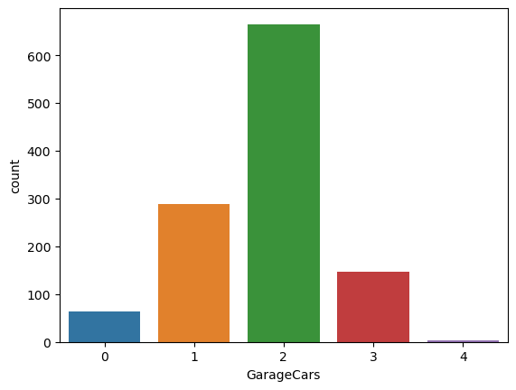
Column- GarageCars
this tells how many cars can be there in the garage.
most of the properties can have 2 cars around 700 properties
then the properties can have 2 cars around 300 properties
then the properties can have 23cars
then the properties can have 0 cars
then very few of them with the properties can have 4 cars

Slide 55
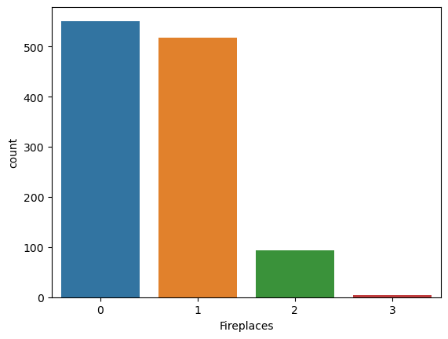
Column-Fireplaces
this tells the fire places in the properties
most of them have no fireplaces
then comes properties with 1 fireplaces
then the properties with 2 fireplace
then very few of them with 3 fireplaces

Slide 56
Pre-processing of the dataset
After the visualization the outliers were checked and removed using Zscore technique (label encoder was used for dealing with the categorical column earlier)
Then the skewness was checked and removed using YEO-JOHNSON technique
Then then TEST.CSV file was called in order to build the model

Slide 57
Training of the model
After the EDA and Pre-processing the data was then called from the TEST.CSV file too as the data was already splitted so there was no need of calling train and test split .
Various regression techniques were used to determine the best fit model , Techniques such as-
Linear regression
Random forest regression
Knn regressor
Support vector regressor
The best fit model was RandomForestRegressor.

Slide 58
Cross validation
After the training of the model we’ve done the cross validation
And the best CV considerd is CV=3 because at cross fold 3 the cv score is 0.8572790977988548
and accuracy score for training is 0.9804907483553653
and accuracy score for testing is -18.492445466720998

Slide 59
Grid search cv
After seeing the score grid search cv is used which gives the predicted cv score of
cross val score 84.7391886947602
And r2 score of
r2_score is -1214.495956927553

Slide 60

Understanding and conclusion
We conclude that RandomForestRegressor is the best fit model among all.
We get a cross val score of 84.7391886947602.
R2 score of -1214.495956927553
There are various factors that effect the pricing of the house or property.

Slide 61

Thank you

